Slide 1

The U.S. Generic
& Biosimilar Medicines Savings Report
FORWARD FOR AMERICA

Slide 2
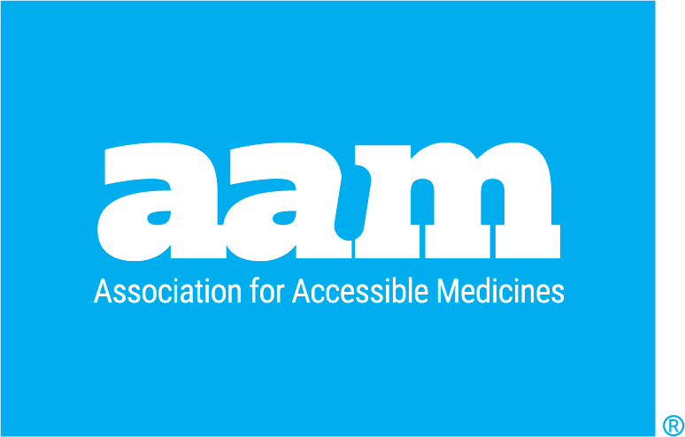




Generics & Biosimilars Offer Benefits Beyond Savings
The Access to Thrive
Strength From Healthier Lives
Healthcare Resilience & National Security
Sustaining the Future of Community Health
Increased access to generic and biosimilar medicines helps patients afford treatments, receive treatments, and live better lives.
Healthy people are dedicated, motivated and active—allowing better outcomes at home, at work and in the community.
A stable healthcare system keeps Americans safe, healthy and productive, during both crisis and calm.
Strong communities retain their strength through demographic shifts, public health shocks and other uncertainties.
Generic & Biosimilar Medicines: A powerful public-health engine that keeps America moving forward!

Slide 3


Key Advocacy Takeaways
Brand Drugs Drive Costs. Generics Drive Savings.
Generic & Biosimilar Medicines
Brand Drugs
89
11
%
%
Total Savings from Generics & Biosimilars
Total generic and biosimilar savings in 2025: $496 billion Total generic and biosimilar savings for the past ten years: $3.6 trillion Generic share of total U.S. prescriptions filled: 89% Generic share of total U.S. prescription drug spending: 11.6% Generic share of total U.S. healthcare spending: 1.1% Total generic savings in Medicare in 2025: $166 billion ($3,011 per beneficiary) Total generic savings in Medicaid in 2025: $70.2 billion ($921 per enrollee)
Rx Drugs Filled
4B
Generic Rx
Rx Drugs Filled
485M
BRAND Rx
11.6
88.4
%
%
Rx Drug Spending
$804B
Rx Drug Spending
$106B
Biosimilars Savings
Savings in 2025: $25.4 billion Total savings since first biosimilar entry in 2015: $81.6 billion Total days of patient therapy since 2015: 3.8 billion Incremental days of patient therapy that would not have occurred without biosimilar competition: 571 million​
Source: IQVIA National Prescription Audit, December 2025.

Slide 4
In 2025, 89% of Prescriptions Were Dispensed as Generics or Biosimilars
Source: IQVIA National Sales Perspectives, December 2025; IQVIA Institute, June 2026.

Slide 5
Biosimilars Market Overview
88
90% of the 118 biologics losing exclusivity between 2025 & 2034—valued at $234 billion overall—currently have no biosimilars in development.
LICENSED
65
Biosimilar savings since 2016
$81.6 BILLION
MARKETED
21
Biosimilars have been used in almost
3.8 BILLION DAYS of patient therapy and have resulted in more than 571 MILLION INCREMENTAL DAYS of therapy
REFERENCE PRODUCTS
As of July 28, 2026
Source: US FDA and AAM Commercial Assessment. Counts denosumab biosimilar launches as one.
Savings and patient day data developed by the Biosimilars Council with IQVIA.

Slide 6
Generics & Biosimilars Are 89% of All Prescriptions, But Only 11.6% of Spending
Generic Prices Continue to Fall
Source: IQVIA National Prescription Audit & National Sales Perspective, December 2025; IQVIA Institute, June 2026.

Slide 7
Traditional Products Provide Vast Majority of Generic & Biosimilar Savings
$3,626B
$832B
$2,795B
Source: IQVIA National Sales Perspective, December 2025; IQVIA Institute, July 2026.

Slide 8
Specialty Generics: Savings Not Guaranteed
70%
60%
Medicaid provisions take effect
50%
40%
30%
20%
10%
-
J
M
M
J
S
N
J
M
M
J
S
N
J
M
M
J
S
N
J
M
M
J
S
N
J
M
M
J
S
N
J
M
M
J
S
2020
2021
2022
2023
2024
2025
Month
Source: Han et al. (March 2026) List Price Reductions Among Brand-Name ICS-LABA Inhalers In 2024 Were Associated With Increased Generic Uptake. Health Affairs

Slide 9
Generics: Only 1.1% of Total U.S. Healthcare Spending in 2025
1.3%
7.8%
2.9%
8.5%
1.1%
16.7%
61.7%
Source: Fiore et al. (June 2026) National Health Expenditure Projections, 2025–34: Strong Utilization Growth Initially, Legislative Impacts Later. Health Affairs 2026. Accessible at: https://www.healthaffairs.org/doi/pdf/10.1377/hlthaff.2026.00642

Slide 10
In 2025 Only 2 Brand Drugs Equaled Total Generics Business;
In 2018 it Took 7
2018
2021
2025
The Top 7 Brand
Molecules =
$55B in Sales
Entire Generic Market = 1,044 Molecules
and $57.7B in Sales
The Top 3 Brand
Molecules =
$55.2B in Sales
Entire Generic Market = 1,072 Molecules
and $53.6B in Sales
The Top 2 Brand
Molecules =
$76.4B in Sales
Entire Generic Market =
1,106 Molecules
And $57B in Sales
$5.2B
Xarelto
$12.2B
Trulicity
$39.9B
Mounjaro
$5.2B
Remicade
$15.9B
Eliquis
$36.5B
Ozempic
$5.5B
Lyrica
$27.1B
Humira
$5.7B
Januvia
$7.1B
Eliquis
$8.0B
Enbrel
$18.4B
Humira
= 50 Generic Molecules
Data based on the Moving Annual Total month of November
Source: IQVIA US Generics & Biosimilars Trends, Issues & Outlook for AAM, February 2026.

Slide 11
Average Generic Price % of Brand Pre-Expiry Price by Generic Entry Year
Source: IQVIA National Sales Perspective, December 2024; IQVIA Institute, June 2025.

Slide 12
According to Nephron Research, Generic Deflation was
-5.8% in 2025
Year-over-Year deflation was consistent with Nephron Research's mid-single digits projection for 2025
In 2025, generic prices deflated -5.8% y/y from 2024, modestly lower deflation vs -6.3% y/y in 2024.
Generic deflation accelerated toward the end of 2025, with the month of December down -7.6% y/y.
As we entered 2026, tariffs moved from near-term to mid-term concern. Nephron Research expected 2026 deflation to run at the high end of the mid-single digit long-term trend.
2025 Annual Deflation -5.8%
-6.3%
-7.5%
-7.5%
-11.4%
NADAC falls -16% m/m, points to pharmacy pressure
Source: Nephron Research Generic Price Auditor, January 2025.

Slide 13
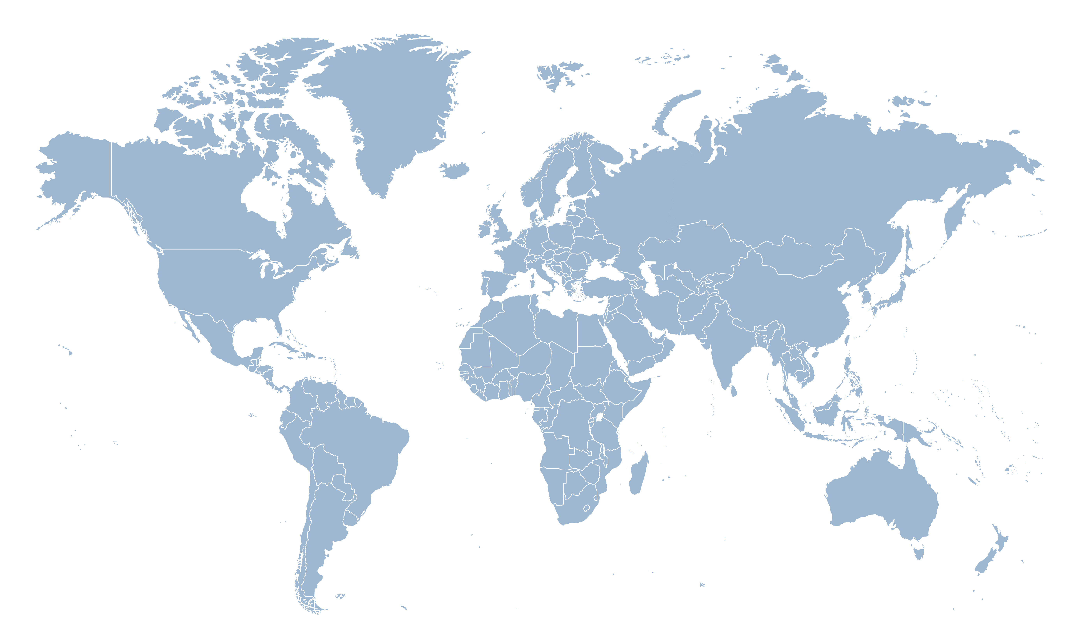
Generics & Biosimilars Have Increased Share of Prescriptions Worldwide
Generic and Biosimilar Market Share (LCUS, SU), 2015 → 2024
Europe
SU: 46% → 53%
LCUS: 22% → 20%
United States
SU: 89% → 90%
Asia/Australia
Africa/Middle East
LCUS: 27% → 12%
SU: 40% → 44%
SU: 49% → 50%
LCUS: 29% → 31%
LCUS: 29% → 33%
Latin America
SU: 53% → 54%
LCUS: 43% → 41%
Source: IQVIA GS&AR, IQVIA, MIDAS MAT Q3 2024, Retail and Hospital, Rx and no Rx. Generics Product Class: Generics + Early Entry Generics. SU= Standar Units. Analysis includes biologics, LCUS = Spend utilizing the local currency converted to United States dollars at constant exchange rates

Slide 14


Biosimilars in the U.S. Face More Patent Challenges Than Other Countries
Source: Association for Accessible Medicines. (July 2025) Anatomy of a Biosimilar Patent Litigation: Problems and Solutions.

Slide 15
Rx Shortages Continue to Seize Headlines
Key therapies
25% of drug shortages are within two fields—oncology and neurology—where patients require consistent and timely access to necessary medications
84%
75
Generics
Shortages disproportionately affect generic drugs
Distinct molecules with active shortages
Down from 98 in 2024
13
Cancer shortages
69%
56%
Products in shortage are typically low-price, with 56% of molecules in shortage priced at $1 per unit or less
13 oncology molecules are in shortage, with the vast majority (N=12) being sterile injectables
Injectable
Sterile injectables are the majority of shortages
Source: IQVIA Institute for Human Data Science. July 2025. Trends in Drug Shortages and ANDA Approvals in the U.S. Available at iqviainstitute.org.

Slide 16
The Top 10 Products by Volume Represent 17% of the Overall Savings in the Past 10 Years
Top 10 Products by Volume in Past 10 Years
Product | Generic Entry Year | Brand Pre-expiry Price (Per Unit) | Price Of Generic Equivalent 2024 (Per Unit) | 10-year Savings ($B) | Percent Savings | 10-year Volume Units Dispensed (B)
Glucophage | 2001 | 0.66 | 0.03 | 49 | 88% | 84.4
Neurontin | 2003 | 1.02 | 0.05 | 72.1 | 94% | 75.6
Lipitor | 2010 | 3.29 | 0.06 | 202.2 | 98% | 63.1
Toprol Xl | 1993 | 0.41 | 0.05 | 19.1 | 82% | 57.1
Norvasc | 2006 | 1.54 | 0.02 | 73.3 | 99% | 48.2
Zestril | 1998 | 0.67 | 0.03 | 30.5 | 96% | 47.6
Vicodin | 1993 | 0.27 | 0.13 | 5.9 | 58% | 38.2
Prilosec | 2001 | 3.31 | 0.06 | 117.7 | 98% | 36.3
Cozaar | 2009 | 1.51 | 0.05 | 51.1 | 96% | 35.3
Diprivan | 1998 | 0.52 | 0.08 | 4.1 | 78% | 28.8
Source: IQVIA National Prescription Audit, December 2025; IQVIA Institute, June 2026.

Slide 17
Across All Therapy Areas, 88% of Volume Is Generics or Biosimilars
Of the Top 30 Therapy Areas, Only 8 Have Less Than 80% of the Volume, 2025
Source: QVIA Institute for Human Data Science. U.S. Medicine Use Trends 2026: Increased Use and Spending Amid Access and Cost Pressures, April 2026. Available from www.iqviainstitute.org.

Slide 18
Generics & Biosimilars Generated an Average of $9.3B in Savings per State
State Level Savings Estimated Based on Retail Prescriptions
Source: IQVIA National Sales Perspective, December 2025; IQVIA Institute, June 2026.

Slide 19
Majority of Prescriptions, and Thus Generic & Biosimilar Savings, Attributed to Commercially-Insured Patients
Share of Generic & Biosimilar Savings by Method of Payment, 2025
Source: IQVIA National Sales Perspective, December 2025; IQVIA Institute, June 2026.

Slide 20
Average Generic Uptake for Small Molecule Generics by Generic Entry Year
Source: IQVIA Institute for Human Data Science. April 2025. Understanding the Use of Medicines in the U.S. 2025: Evolving Standards of Care, Patient Access, and Spending. Available from iqviainstitute.org.

Slide 21
While Generics Are Generally Preferred, Over 25% of New Generic Claims Are Rejected by Payers 2 Years After Generic Entry
Source: IQVIA LAAD Sample Claims Data, December 2024; IQVIA Institute, April 2025.

Slide 22
AMP May Fluctuate Due to a Change in
Manufacturer-Purchaser Contracting
Quarter 1
Quarter 2
Product X
WAC: $1.00 per bottle
($.01 per unit)
(1 unit = 1 pill)
Product X
WAC: $1.00 per bottle
($.01 per unit)
(1 unit = 1 pill)
In Quarter 2, Purchaser C buys an interchangeable product from Manufacturer Y at the same $.008 per pill
500 bottles at $1.00 per bottle ($.01 per pill)
1000 bottles at $.90 per bottle ($.009 per pill)
2000 bottles at $.80 per bottle ($.008 per pill)
500 bottles at $1.00 per bottle ($.01 per pill)
1000 bottles at $.90 per bottle ($.009 per pill)
Purchaser A
Purchaser B
Purchaser C
Purchaser A
Purchaser B
Purchaser C
In quarter 1, Purchasers A, B and C bought Product X at varying prices per unit. Quarter 1 AMP: $.857 per 100 units
In quarter 2, Purchaser C ended its contract with the manufacturer. Quarter 2 AMP: $.933 per 100 units
Source: Avalere Health (February 2025) White Paper: The Medicaid Drug Rebate Program and Considerations for Generic Markets. https://advisory.avalerehealth.com/insights/white-paper-the-medicaid-drug-rebate-program-and-considerations-for-generic-markets
Change in AMP: +8.9%

Slide 23
IRA Timeline Harms Generic & Biosimilar Competition
1
4 years = The earliest date a paragraph IV certification can occur for New Chemical Entities
5 years = When the 30-month stay begins if a paragraph IV certification has occurred
7 years = IRA date for which a brand drug is eligible for drug price negotiation
7.5 years = Earliest date that a generic drug can receive FDA approval*
12.5–14.5 years = Average time before a generic drug can launch (i.e., when all patents are resolved)
Generics chart adapted from Kesselheim et al: https://www.ncbi.nlm.nih.gov/pmc/articles/PMC8504843/figure/cts13046-fig-0001/
Generics
0
1
2
3
4
5
6
7
8
9
10
11
12
13
14
15
16
17
18
1
Biosimilars
0 years = Reference product licensed by the FDA
2–6 years = $100–$300 million biosimilar development decision
6–9 years = Timeline from analytical characterization to licensure
11 years = Reference biologic is eligible for drug price negotiation**
12 years = Earliest date that a biosimilar can receive FDA licensure
~18 years = Average of first biosimilar launch
*Assumes a paragraph IV certification has occurred between 4 & 5 years, triggering a 30-month stay that begins at 5 years
** CMS may delay negotiations for certain biologics with pending biosimilars for up to two years, upon the biosimilar manufacturer’s request, provided that the biosimilar can demonstrate that there’s a high likelihood of marketing in that timeframe.

Slide 24
Entresto: Competition Beats Price Controls
Generic competition for Entresto Resulted in More Patients Receiving Drug, Decrease in Average Cost Per Prescription
Source: AAM Analysis of IQVIA National Prescription Audit & National Sales Perspective, May 2026

Slide 25
Approval Time (Months) by Cohort of Receipt
GDUFA I
GDUFA II
GDUFA III
Source: Darby Kozak (April 2025), Working Together to Increase Access to Generic Drugs, Accessible at https://sbiaevents.com/gdf2025/

Slide 26
FDA Has Approved 88 Biosimilars Since 2015
Source: IQVIA National Prescription Audit, December 2025; IQVIA Institute, June 2026.

Slide 27
Biosimilars Generated $81.6B in Savings Since 2016
Source: IQVIA National Prescription Audit, December 2025; IQVIA Institute, June 2026.

Slide 28
Biosimilars: Now a Core Element of Patient Care
3.8
571
BILLION
Total Days of Therapy for Patients on Biosimilars
MILLION
Additional Patient Days Due to the Availability of Biosimilars
Source: IQVIA analysis of defined daily dose information and product volume.

Slide 29
Biosimilar Development Is Concentrated in High-Sales Biologics with Near-Term Patent Expiries in the Next 5 Years
Share of total biologic expiries
n=118
46%
Biosimilars in development
n=11
9%
50%
Expiry in near term (2025–2029)
n=24
41%
High sales biologics
n=48
54%
No biosimilars in development
n=13
11%
50%
Expiry in long term (2030–2034)
n=24
100%
No biosimilars in development n=24
20%
Biologics with patient expiries 2025–2034
n=118
3%
Biosimilars in development
n=1
<1%
51%
Expiry in near term (2025–2029)
n=36
59%
Low sales biologics
n=70
97%
No biosimilars in development n=36
30%
49%
Expiry in long term (2023–2034)
n=34
100%
No biosimilars in development n=34
29%
Source: Accessing the Biosimilar in the U.S.

Slide 30
Biosimilar Market Share Averaging 23%, Down from ~40% from Last Year Due to New Biosimilar Launches
Source: IQVIA National Sales Perspective, December 2024; IQVIA Institute, June 2025.

Slide 31
In First 3 Years After Biosimilar Entry, an Average Originator Brand Suffers a ~23% Drop in ASP and a Nearly Two-Fold Increase in List-to-Net Gap
Molecule-Average ASP Is Declining Faster Than Originator ASP Due to Lower Prices of Biosimilars
Molecule ASP
Originator ASP
Originator WAC to ASP Gap
On average,
-39%
in first 3 years of
Biosimilar Market Presence
On average,
-23%
in first 3 years of
Biosimilar Market Presence
On average,
1.8x
Increase in off-WAC discounting in first 3 years of Biosimilar Market Presence
Source: US Market Access Strategy Consulting analysis, CMS ASP Data, NSP Sales, Redbook WAC Data

Slide 32
Second-to-Market Biosimilar Launched Within 3 Years of the First Has Potential to Nearly Double the ASP Pressure
Further Competition (Third and Later Biosimilars) Does Increase ASP Pressure, but Marginal Impact of Further Launches Is Lower Than That of the First and Second Biosimilars
+29%
+58%
+37%
+20%
+75%
+19%
1 Biosim | Filgrastim, Epoetin Alfa
2 Biosims | Infliximab, Bevacizumab, Ranibizumab
3+ Biosims | Pegfilgrastim*, Trastuzumab, Rituximab*
# of Biosimilars
Time Since Launch of First Biosimilar
Year 1
Year 2
Year 3
Source: US Market Access Strategy Consulting analysis, CMS ASP Data, NSP Sales, Redbook WAC Data

Slide 33
While the Launch of Co-Branded Treatments Grew Biosimilar Use in Q2 2024, PBMs Continue to Play a Large Role in Patient Access to Biosimilars
Most Biosimilar Growth Can Be Attributed to Co-Branded Hyrimoz; Volume Still Trails AbbVie’s Immunology Portfolio
Co-Branded Hyrimoz is Driving Increased Biosimilar Utilization
Large PBMs Continue To Favor Humira or
Co-Branded Options
Product Hopping Outpaces Biosimilars
2,822K
3,155K
3,667K
1,478K
9%
9%
73%
72%
34%
33%
32%
28%
4%
4%
Source: IQVIA LAAD 3.0, US Market Access Strategy Consulting analysis.

Slide 34
Biosimilar Development Streamlining Reduces Costs and Time
~$100M–$300M
7–8 years
2–7
5–6 years
40–200
60–250
~$50M–$75M
5
10–30
10–40
1-20†
10–30
10–40
10–40
Preclinical
Ph 1
Ph 3
Registration
Registration to Approval
3-Way PK†
Source: Figure adapted from Samsung Bioepis (March 2025), Biosimilar Market Report Q2 2025.
* Costs & Development Timelines are estimated ranges
† 3-way PK estimates: see Webster & Woollett (May 2017), A ‘Global Reference’ Comparator for Biosimilar Development; see also FDA News Release (March 2026), FDA Takes Further Steps to Streamline Biosimilar Development and Make Medicines More Affordable.

Slide 35
Vertical Business Relationships Within the U.S. Drug Channel, 2026

Slide 36
Rebate Walls Increase Costs to Patients
Metric | Formular | Drug A (rebate) | Drug B (no rebate)
WAC | A | $5,000 | $1,875
AWP | B = A × 1.2 | $6,000 | $2,250
AWP Discount | C | 20% | 20%
Ingredient Cost | D = B × (1 − C) | $4,800 | $1,800
Rebate (%) | E | 60% | 0%
Rebate ($) | F = A × E | $3,000 | $0
Net Cost | G = D − F | $1,800 | $1,800
Patient Coinsurance | H = D × 20% | $960 | $360
Plan Liability | I = G − H | $840 | $1,440
Source: Drug Channels Institute

Slide 37
Concentrated PBM Buying Power Suppresses Ability for Low-Cost Medicines to Compete
Generics
Product Type | Where Product Reaches Patient | Purchaser or Decision-Maker | Entities & Market Share
Traditional Generic | Local Pharmacy | Generic Buying Consortia | Three entities control 90% of the market: Red Oak Sourcing Walgreens Boot Alliance with AmerisourceBergen coupled with Econdisc Contracting Solutions McKesson OneStop + ClarusOne (Walmart)
Specialty Generic | Specialty Pharmacy | Specialty Pharmacy | Three entities control 2/3 of the prescription drug revenue: CVS Specialty Accredo/Freedom Fertility Optum Specialty Pharmacy
Biosimilars
Product Type | Where Product Reaches Patient | Purchaser or Decision-Maker | Entities & Market Share
Medical Benefit | Physician Office or HOPD | PBM/Health Plan; Then Prescriber | With respect to PBMs, 3 entities processed 80% of all equivalent prescription claims: the Caremark business of CVS Health, the Express Scripts business of Cigna the Optum Rx business of UnitedHealth Group
Pharmacy Benefit | Specialty Pharmacy | PBM/Health Plan; Then Specialty Pharmacy | *See Generics information related to PBMs and specialty pharmacy

